Slide 1
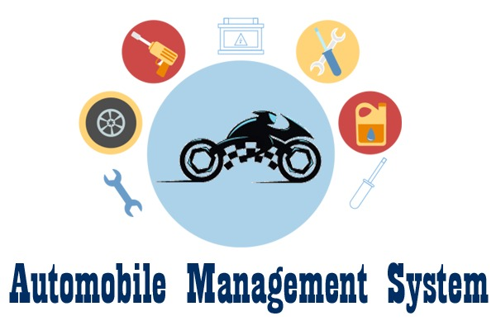

Slide 2

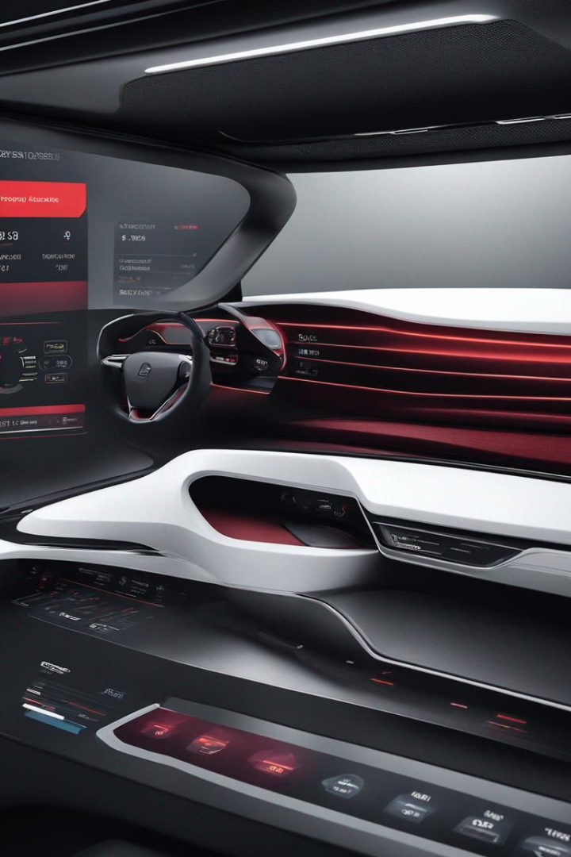


Introduction to Automobile Management System
An automobile management system is a comprehensive software solution designed to streamline and optimize the operations of automobile-related businesses. From vehicle maintenance to inventory management, it offers seamless integration and efficient data handling for improved productivity and customer satisfaction.
by Undi Jashuva Prasanth Kumar

Slide 3



Benefits of Implementing an Automobile Management System
Enhanced Productivity
Cost Savings
Enhanced Customer Satisfaction
Through optimized resource allocation and streamlined operations, the system delivers significant cost-saving opportunities.
Implementing an automobile management system leads to improved workflow efficiency, optimized processes, and better resource utilization.
The system ensures improved service quality, timely response, and a customer-focused approach, leading to higher satisfaction levels.

Slide 4
Key Features of the Automobile Management System
Inventory Management
Vehicle Maintenance
Customer Database
Comprehensive customer profiles, purchase history, and communication logs.
Efficient tracking and control of parts, supplies, and other inventory items.
Automated maintenance scheduling, tracking, and detailed service history management.

Slide 5




How the Automobile Management System Works
Data Collection
Accumulation of vehicle and customer data through various sources.
Processing & Analysis
Systematic processing and analysis of the collected data for insights and decision-making.
Automated Workflows
Integration of automated workflows for maintenance, inventory, and customer relationship management.

Slide 6
Future Trends in Automobile Management Systems
1
AI Integration
2
Blockchain Adoption
Increased use of AI for predictive maintenance and personalized customer experiences.
Utilization of blockchain for secure and transparent vehicle history records and supply chain management.
3
Enhanced Connectivity
4
Data-Driven Insights
Advancements in IoT and connected smart devices for real-time data monitoring and analysis.
Emphasis on data-driven decision-making and predictive analytics for operational optimizations.

Slide 7
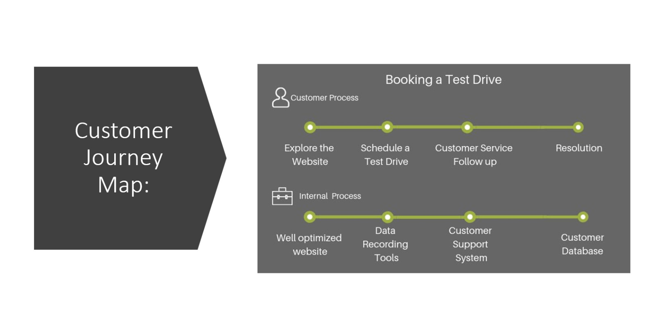

Slide 8
Conclusion and Next Steps
Adoption Consideration
Continuous Upgrades
Training and Implementation
Businesses should consider integrating an automobile management system for streamlined operations and enhanced customer experiences.
Regular system upgrades and adaptation to emerging technologies are crucial for sustained competitiveness.
Proper staff training and effective implementation planning are essential for successful system utilization.

Slide 9
